Slide 1
Dean and CEO Expectations of Department Chairs
Steven Zweig, MD, MSPH
Interim Dean University of Missouri School of Medicine
Professor, Family and Community Medicine
February 2020 ADFM Annual Conference Breakfast Session

Slide 2
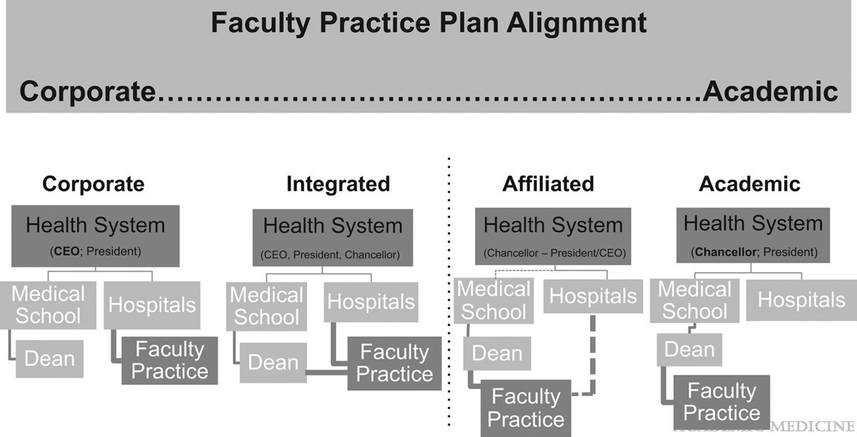
Administrative structures
Pelligrino, et al. Governance of Academic Health Centers. Academic Medicine 2019;94:12-16

Slide 3
Expectations of CEOs and Deans of clinical department chairs
For all new and ongoing chair positions
  What are the expectations of the leaders?
  Are they aligned?
  Do you have the resources to meet those expectations?
  What can I do to advance the department and meet expectations of Dean/CEO?
  With whom can I align to gain the support required?
  What will help to sustain support from Dean/CEO?
  What are the leadership skills required to achieve expectations?

Slide 4
Are expectations of Dean and CEO the same?
Survey of deans and CEOs at US medical school on the importance of chair performance in six categories (mission prioritization, leadership responsibilities, leadership values, skill sets, barriers to success, and competitive differentiators).
Past record of successfully achieving goals was most important factor looked for in recruiting new chair – followed by effective communication skills and fit with institutional culture.
Both thought failure to hold faculty accountable was biggest barrier to success, followed by poor execution and ineffective communication.
Both agree that establishing trust was first priority of new department chair.
  Souba W et al. Academic Medicine 2011;86:974-981

Slide 5
Differences in Deans’ and CEOs’ rating of chair characteristics
CHARACTERISTIC | DEAN | CEO
Mission |  | Patient care
Leadership responsibilities |  | Ensuring quality
Leadership values | Mentoring | Results orientation
Barriers to success | Ineffective mentoring | Lack of results orientation
Competitive differentiation | Educating future physicians | Cutting edge technology
 |  | High-quality patient care

Slide 6
Roles of the
Clinical Department Chair
Chair as institutional leader
  Lead during times of change – we need to be “agile, nimble, and able to outperform competitors.”
  “Are you only an advocate or are you a responsible leader?” PM
Chair as departmental leader and manager
  Budget, staff, teaching, residency – be a role model
  But don’t do stuff others can do because there is a lot only you can do
Chair as talent development officer
  Collegiality, coaching, dealing with conflict, staff concerns, recruiting
  Succession planning – even if you lose people
Chair as relationship manager
  Across departments, institutions, organizations
  Remember, you will need to work with person on something else next week
  Mallon WT, Grigsby RK. Leadership. AAMC. 2017. Washington, DC.

Slide 7
Success strategies in dealing with leadership:
10 things department chairs should do
Recognize the dean wants you to be successful.
Be straight in conversations.
Be a team player with other chairs.
Don’t let intradepartmental struggles get to the dean.
Don’t tell the dean stuff you should be telling the offending person.
Don’t break university rules (or laws).
Don’t condone sexual harassment or discrimination.
Don’t send hateful emails.
Make compensation and incentive policies rational, fair and transparent.
Maintain institutional vision and departmental focus.

