Slide 1
Well-being: Impacting Culture Now and Moving Forward
Chantal Brazeau, MD
Assistant Dean for Faculty Vitality, NJMS, RWJMS
Chief Wellness Officer, RBHS
Notes:
Final power point by January 15
Presentation is Feb 20 th 2 05 to 3 05 ET (immediately following view from the dean’s office- FM chairs share their perspective now as dean)
Remember to appreciate because that is part of well being

Slide 2
Objectives
By the end of this session, participants will be able to:
1) Identify where their organization stands on the steps in an organization's journey toward a culture of well-being
2) Describe what they can do as a leader in their department to enact change for those with whom they work
3) Bring home specific examples of strategies to foster the culture of wellness in their department

Slide 3
Culture is…
…a collection of assumptions, practices, and beliefs that we create as part of belonging to a group or organization, including the values we espouse and the ways we express these
Notes:
Culture is huge
ADFM friends

Slide 4
Culture cannot be “implemented”, it has to be lived and breathed
Culture is built one person at a time
O’Malley, Baker; Organizations for People
Notes:
And also even though culture is an expansive concept, I do believe that it is built one person at a time and this is something we can do as leaders- role model it in our larger environment and smaller work units and advocate for change in our academic institutions and our healthcare organizations.

Slide 5
Go to: www.menti.com
Enter code: 29 54 6
Notes:
First I want to start with an exercise that we did at our school. We are in the middle of strategic planning at our university and we have a sub committee on culture, institutional environment, morale and well-being.
We decided to get feedback from faculty as to what they want as part of the University.
So I’d like you to go on your cell phones to www.menti.com
Enter the code listed here
And then answer the following question, as you think about culture: a collection of assumptions, practices, and beliefs that we create as part of belonging to a group or organization, including the values we espouse and the ways we express these

Slide 8
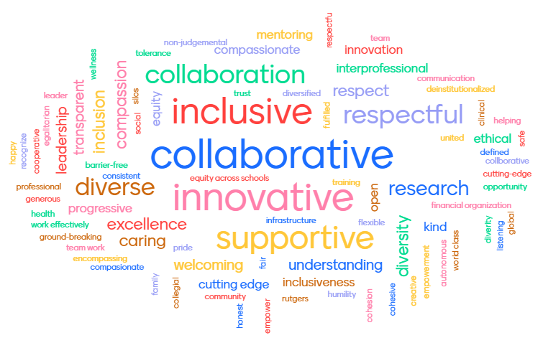
“What are three words that come to mind to describe the culture you would like to see at your organization?”
www.menti.com, enter code
Notes:
These are the words we collated at our University

Slide 9
What it Means to be Well
Notes:
In a separate context, we did a survey about well-being at New Jersey Medical School a few years ago, with 6 open ended questions that were formally analyzed with qualitative analysis techniques. We had over 1700 concepts or short phrases in total and this is what faculty said in response to being asked what it means to be well, in context of our work survey.
What is the common thread to all these word clouds? Those are all very human values, not so much the technical aspects of our work, but very human values about working together, making a difference, appreciation, respect, diversity.
The way I see it, people want to be viewed as whole people at work
This broad view of well being is very much what people intuitively want
I want to share with you the results of a survey
There were 878 responses by faculty in response to a total of 6 questions. Many responses included comments about various issues. We followed a formal qualitative analysis process to classify these issues into common themes and how frequently the themes were mentioned in faculty responses. This led to a total of 1771 short phrases or key words representing these issues and classified by themes.
The question was: What does it mean for you to be well?

Slide 10
Our Culture: Stated Values vs. our Reality
We Say | We Do
Self-care is important | Excessive hours, work comes first
Prevention better than treatment | Lack of attendance to to our own healthcare needs
To err is human | Perfectionism and low self-compassion
We have a supportive community | Low vulnerability with colleagues
Adapted from Healing the Culture of Medicine Shanafelt et al Mayo Clinic Proc. 2019;94 (8); 1556-1566
Notes:
There are often differences between what we aspire to and what we actually live in our culture

Slide 11
Our Culture: Stated Values vs. our Reality
We Say | We Do
Physicians are professionals (we trust them) | Pre authorization, excessive documentation
Physicians are an important resource | Excessive clerical burden
To err is human | Mistakes individual or system?
High quality is top priority | System drivers of burnout erode quality, focus on RVUs
Adapted from Healing the Culture of Medicine Shanafelt et al Mayo Clinic Proc. 2019;94 (8); 1556-1566

Slide 12
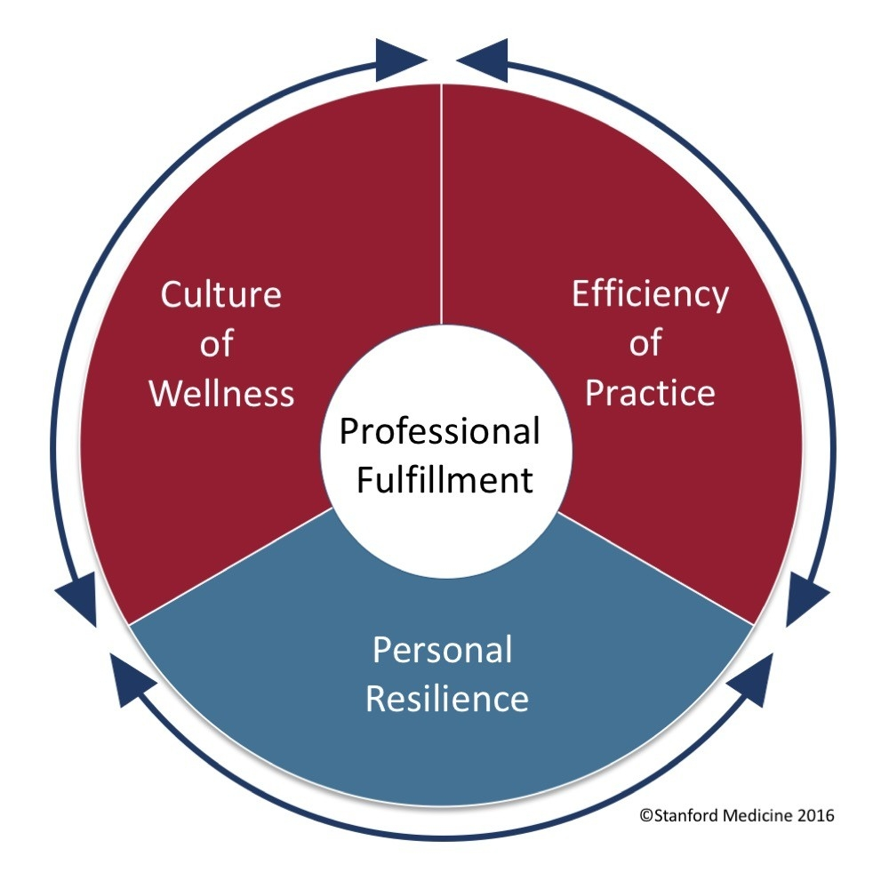
A Broad Integrated View of Well-Being
Values
Leadership
Values alignment
Voice/input
Community/ collegiality
Peer support
Culture of compassion
Infrastructure Efficiency
Systems/ processes
EHR “usability”
Work flows
Team-based work
Individual skills
Self-care; stress reduction
Mindfulness/Self-awareness
Meaning in work
Work-life integration
Conceptual Model:
© Copyright Board of Trustees of the Leland Stanford Jr. University. All Rights Reserved
Notes:
So how do we get to what we say we value?
I really like the Stanford Conceptual Model because it pulls it all together- it applies all the values and that humanity that we want to the reality of healthcare.
You may already be familiar with it: (describe it)
And all three components of the wheel interrelate
How do we advocate for it?
How do we role model it?
What does it mean to take on the pieces
Will not focus on individual
We need to talk about well-being in a broad sense.
Well-being is deeply impacted by the work environment so that environment needs to be included in our view of well-being particularly the work culture and the efficiency of the work environment.
Work culture: How is professional well-being part of the culture of the workplace, how is it accepted and embraced by leadership, how do values of the individual fit with the values of the workplace, is there collegiality/ community, do employees have a voice in solving problems (i.e. is there collaboration as opposed to a top down approach), does the workplace/leadership support or facilitate individual resilience?
Efficiency of our workplace: NOT ALL ABOUT Productivity How do teams work together? How efficient is the flow in the clinical practice or the laboratory or the administrative processes? Is teaching organized efficiently? Working in an efficient environment, with good team functioning is fulfilling. Doing high quality work is fulfilling, and meaningful to people. Steps that leadership and employees take collaboratively take to improve efficiency can greatly enhance wellness at work.
Well-being is not the same as lack of burnout. Burnout at work is defined as emotional exhaustion, cynicism and reduced efficacy. For sure we want to reduce or even eliminate burnout at work, but it’s not enough to simply stop burnout. People need to have positive experiences at work to feel well, not simply a lack of negative experiences.

Slide 13
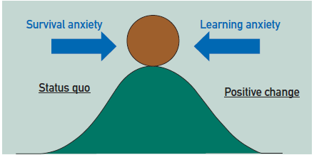
Advocacy
Having a threat to move away from and reducing the anxiety about the “new”
Healing the Culture of Medicine Shanafelt et al Mayo Clinic Proc. 2019;94 (8); 1556-1566
Notes:
Advocacy begins with an understanding and appreciation that change is difficult.
Just like we understand our patients in motivational interviewing for them to have a reason to quit

Slide 14
What Causes Survival Anxiety at your Organization?
Medical Errors
Quality Metrics
Culture of Safety
Physician dissatisfaction
Recruitment and retention problems
Productivity
Suicide
Notes:
All of these can be used to make an argument to support the healthcare workforce

Slide 15
Where is your Organization on the Journey?
Awareness
Committee
Individual
Knows drivers
Peer-support
X-sect survey
Considered in implementation
Business case
Drivers-based practice redesign
Coaching
Long. survey
Physician voice
Work-unit interventions/not assessed
Community
Known impact on org. objectives
Considered in key decisions
Funded program
Clerical burden measured/reduced
Leadership dev.
System interventions/ assessed
Work flow efficiency
Impacts key decisions
Leaders share accountability
CWO in C suite
Endowed/guides other organizations
Strategic investment
Culture of Wellness
E
X
P
E
R
T
T
R
A
N
S
F
O
R
M
A
T
I
V
E
N
O
V
I
C
E
M
I
N
O
R
Novice
Beginner
Competent
Proficient
Expert
1
2
3
4
5
Adapted from: Shanafelt, T et al, The Business Case for Investing in Physician Health, JAMA, Int Med, 217:177

Slide 16
AMA Joy in Medicine Health System Recognition Program
https://www.ama-assn.org/system/files/2020-10/joy-award-brochure.pdf

Slide 17
Clear Steps to Help Reduce Learning Anxiety
 | Bronze | Silver | Gold
Commitment | Well-Being Committee (separate from EAP) | 0.5 FTE exec. position | Formal strategic plan on well-being
Assessment | Aggregate findings survey are shared | Annual survey (Mini-Z, MBI, Mayo WBI, Stanford phys. wellness survey) | Cost of burnout are reported annually to leadership
Leadership | Assessment (e.g. Mayo Leadership Index) and appoint staff to query outdated admin burdens | Annual leadership assessment and leader development program and query about admin burden | Show responses to gaps in assessment and dismantle identified admin burdens
Efficiency of Practice | Work Outside of Work (WOW) measured (EHR) | WOW results reported to leadership | Show intervention to reduce WOW
Teamwork | Assess with TeamStepps. Teamwork Perception or other | Percentage of orders that have team contribution measured and shared | Show intervention to improve teamwork based on survey
Support | Peer support program for adverse clinical events | Peer support program for collegiality | Structured program for community (e.g. peer discussion groups)

Slide 18
Leadership
Culture of Wellness
Each 1 point increase in leadership score strongly associated with:
3.3% decrease in likelihood of burnout (p<.001)
9% increase in satisfaction (p<.001)
Validated scale: Organizational Leadership; Steven Swenson and Tait Shanafelt, licensed by Mayo Clinic
Impact of Organizational Leadership on Physician Burnout and Satisfaction, Shanafelt et al, Mayo Clin Proc. 2015;90(4):432-440
Notes:
Broad view of leadership
Sets the tone- viewing wellbeing as any other quality in the work environment means to measure it
Faculty in academic settings are frequently in positions where they can lead, whether they are part of a clinical team, leaders of an initiative, teaching students or mentoring faculty or in higher leadership. As such, they can normalize and role model wellness behaviors with their colleagues, co-workers or clinical team members. They can advocate for wellness in their immediate work setting, in the hospital or larger organization. They can be an inherent part of a culture of wellness, to help counteract the culture of “toughness” and self-denial that is so prevalent in healthcare settings. A work environment that embraces wellness will measure or evaluate well-being and indicators of work fulfillment in regular surveys to show that this is important, and to know where to improve.

Slide 19
Recognize/appreciate Develop/ find meaning
Notes:
Some important leadership qualities measure in that instrument
Recognizing and appreciating: Naming people for their contributions, “brag board”, in the time of COVID importance of having concrete gestures of gratitude-like food
Develop/find meaning: Help people have a mentor who does not participate in their evaluation and is entirely devoted to their growth and career development, but also know the core values of our faculty to help steer them or connect them with opportunities, to keep in the back of our minds as the department evolves

Slide 20
Involve people in solutions, problem-solving, goal setting Communicate transparently Be inclusive- appreciate different view points
Notes:
NO work environment is perfect
Ask people to help solve problems and be part of the solution
Help people express their views
While it may be tempting to think that as leaders we should provide solutions and carry the burden for our department, which we do to some degree, we need to balance this with a respect for the knowledge within our faculty, and the fact that having a voice is important to feeling fulfilled. Even if we a leaders do not ultimately follow every faculty’s suggestion, the fact that it is being considered conveys respect for professional well-being. So having problem solving meetings can help this and I will give an example of a well-being meeting.
Appreciate different points of view
The richness of different backgrounds and different views people at work both from their professional roles and from their personal background

Slide 21
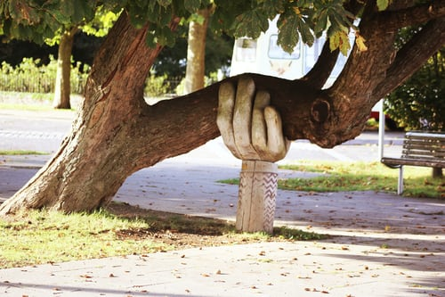
Collegiality and Peer Support
Culture of Wellness
Colleagues as “whole people”- beyond job title
Starting meetings with good news, sharing
Protected time for group discussions
“Schwartz Rounds”, Balint groups
Formal peer-support
Notes:
Starting meetings with good news: Vivek Murthy Former Surgeon General Loneliness in the work place- starting meetings with one person highlighted at the beginning of each meeting.
Swartz Rounds: “The Schwartz Rounds® program, now taking place in more than 440 healthcare organizations throughout the U.S., Canada, Australia, New Zealand and more than 190 sites throughout the U.K. and Ireland, offers healthcare providers a regularly scheduled time during their fast-paced work lives to openly and honestly discuss the social and emotional issues they face in caring for patients and families. In contrast to traditional medical rounds, the focus is on the human dimension of medicine. Caregivers have an opportunity to share their experiences, thoughts and feelings on thought-provoking topics drawn from actual patient cases. The premise is that caregivers are better able to make personal connections with patients and colleagues when they have greater insight into their own responses and feelings.
A hallmark of the program is interdisciplinary dialogue. Panelists from diverse disciplines participate in the sessions, including physicians, nurses, social workers, psychologists, allied health professionals and chaplains. After listening to a panel’s brief presentation on an identified case or topic, caregivers in the audience are invited to share their own perspectives on the case and broader related issues.”

Slide 22
A Moment of Silence
Notes:
some leaders in our organization are honoring those we have lost during COVID-19 by adding a Moment of Silence to their meetings. In addition, some take a few minutes to ask attendees to share their hopes, or what they are grateful for, during these times. Again, this connects us as whole human beings.

Slide 23
Psychological Safety during Virtual Meetings
Yes/No anonymous polls (vs. hand raise) before a sensitive discussion
Chats can distract – turn off for vital discussions
Breakout rooms for psychologically safe small group discussions
Central view for main speaker to better see non verbal cues
Replicate “water cooler moments” with text, phone or e-mail FU
How to Foster Psychological Safety in Virtual Meetings, Edmondson, Daley, Harvard Business Review, August, 2020

Slide 24
NJMS/RWJMS CIRCLE
Peer Talk and Text Groups
Colleagues Involved in Reaching Colleagues through Listening and Empathy
Open enrollment
Self-selected group formation
Longitudinal, twice monthly, 5-8 faculty, CME
Choice:
TALK: synchronous face-to-face or virtual
TEXT: asynchronous on a secure platform
Notes:
Can’t overemphasize the importance of peers during usual times and during COVID-19

Slide 25
NJMS/RWJMS
ONE 2 ONE 2 CARE
Colleagues Aligning to Respond with Empathy
31 faculty/physicians peer-supporters
Trained in peer support techniques
One-on-one support on-the-spot or scheduled
For colleagues after challenging work situations
Monthly meetings and CME for peer supporters

Slide 26
A Culture of Compassion/Valuation
Self-condemnation vs. self-encouragement/self-valuation
Self-denial vs. self-care
Criticism/blame vs. system view
of medical mistakes
Safety when pointing out problems
or concerns with well-being
Notes:
Essentially encouragement of self and others
Recognize that many of us have very high self-expectations
We tend to speak very differently to ourselves than we do to others
Ole model self- valuation
Where mistakes and concerns about wellness can be discussed much like the movement in quality of care- realized that instead of blaming a person we should look at factors in the system that could have prevented the error

Slide 27
The Challenge of Efficiency of Practice
Larger systems problems can breed
a sense of futility
The “pebble in the shoe” problems
are important too
Notes:
Employed health professionals/faculty who are not involved in the hiring and management of employees may feel that they can do very little and that they have no control over their work environment.
This domain of wellness is also impacted by larger national healthcare system issues which are slowly being addressed, as noted above. The user-friendliness of the electronic health record (EHR) also impacts the efficiency of the clinical team, and improvements in the EHR industry will take time. All these factors can make this domain of wellness appear more elusive and difficult to attain.
Can be discouraging tempting to give up
However there is evidence that even making small changes in your work environment can help.

Slide 28
Holding a Wellness Meeting in your Department
Review the domains of professional fulfillment- Appreciate what you already do
Brainstorm a wellness “wish-list”: The Pebbles (voice)
Prioritize your “wish-list” items
Choose 1-2 initiatives with high impact/low investment
Decide on suggestions for the school (advocacy)
Follow-up (Quality assurance cycle)
Notes:
Can a happen in a clinical setting, a research setting any academic department
Hold a meeting where the focus is on well being
Where the quality assurance is focused on well-being

Slide 29
Hear
Me
Protect Me
Prepare Me
Support Me
Care for Me
Supporting Well-Being during COVID-19
Shanafelt et al. Understanding and Addressing Sources of Anxiety among Health Professionals during the COVID-19 Pandemic. JAMA, 2020;323(21):2133-4

Slide 30
Supporting Well-Being during COVID-19
Psychological First Aid
Safety
Calm
Efficacy
Connectedness
Hope
Shultz,J, Forbes, Disaster Health 2:1, 3–12; January/February/March 2014;

Slide 31
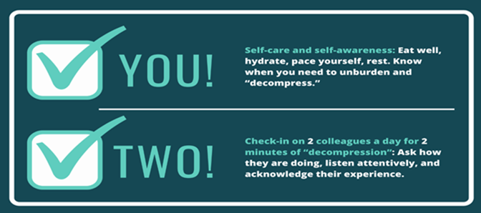
The Importance of Peers
“Buddies”
“Check-in”
Groups
C. Brazeau, M. Soto-Greene, Robert Wood Johnson Medical School Marketing Team

Slide 32
Culture Post COVID-19
Brought attention to well-being
Post-traumatic growth
Re-evaluation of missions and core values
Sustained Stress
disrupts status quo
New Initiatives
can pave the way
Healing the Culture of Medicine Shanafelt et al Mayo Clinic Proc. 2019;94 (8); 1556-1566

Slide 33
Go to: www.menti.com
Enter code: 29 54 6

Slide 35
QUESTIONS?
chantal.brazeau@rutgers.edu

